Slide 1
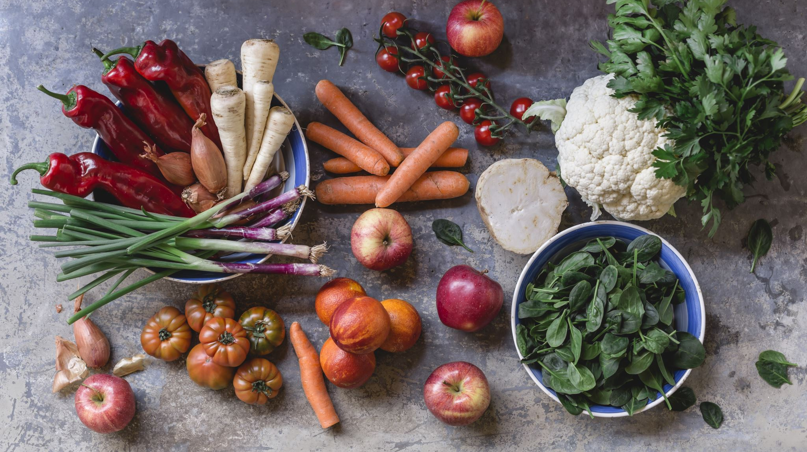
Increasing Organic Product Sales: Customers Analysis and Recommendations
Yanghua Zhang
11-20-2023

Slide 2
Introduction
Supermarket is offering a new line of organic products
Identifying key customer segments and increase the sales of organic products
Organics data set contain 13 variables and over 22,000 observations
Notes:
Hi, our supermarket has recently launched a new line of organic products and we want to understand our customers' preferences better. To achieve this, we use customer loyalty program data that includes whether these customers purchased any of the organic products through our customer loyalty program. By analyzing the data collected on the participants' purchases, as outlined in the 'organics.csv' file, we aim to gain valuable insights. Our primary objective is to identify the customers who are most likely to purchase these organic products. This analysis will allow us to create a comprehensive profile of the typical organic product purchaser. Through this loyalty program initiative and our analytical efforts, we hope to bring our offerings in line with our customers' preferences and improve our market position in the organic product sector.

Slide 3
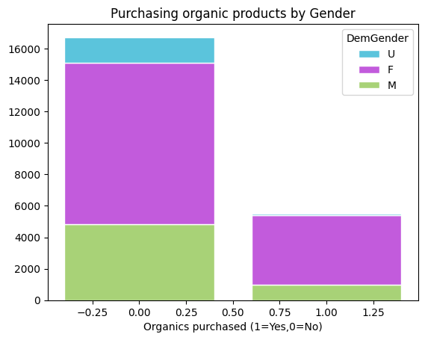
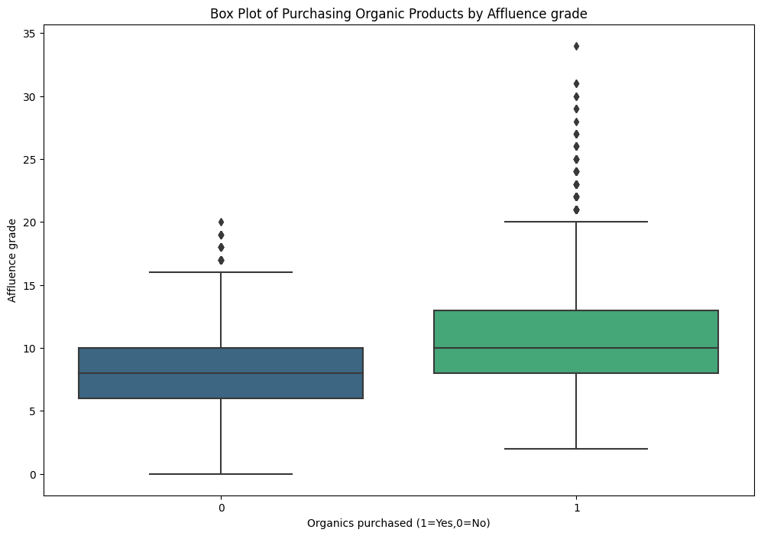
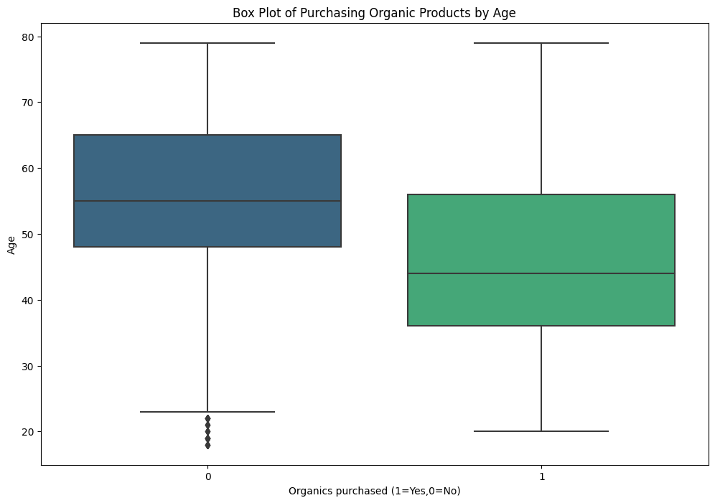
Exploratory Analysis Overview
Noticeable differences between customers who purchase organic products and those who do not in terms of
Gender
Affluence grade
Age
Notes:
Based on these graphs, we have noticed that there are significant differences between customers who purchase organic products and those who do not in terms of gender, affluence grade, and age.
First, females are more likely to purchase organic products compared to males and those with unknown gender.
Second, customers with higher affluence grades are also more inclined to purchase organic products.
Lastly, younger customers tend to purchase organic products more frequently compared to older customers.

Slide 4
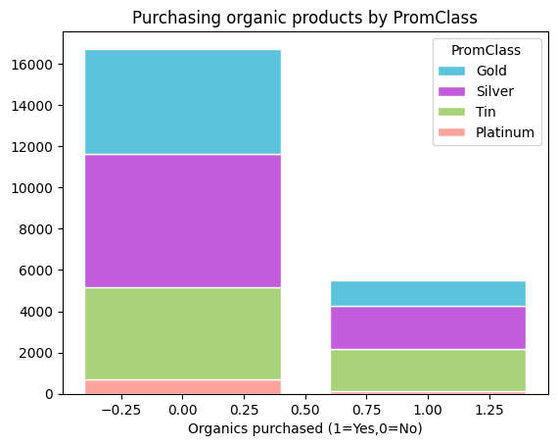
Exploratory Analysis Overview
Organic Product Purchase Rates by Loyalty Status Groups
Noticeable differences in the percentage of customers who purchase organic products across the different loyalty status groups.
Notes:
There is noticeable differences in the percentage of customers who purchase organic products across the different loyalty status groups.
For example, the percentage of platinum customers who purchase organic products is lower than that of the other three customer types.
The percentage of customers who purchase organic products is higher among silver and tin customers than gold and platinum customers.

Slide 5
Model Summary
Make correct prediction at 81% of time.
About 41% proportion of organic purchased was identified correctly
 | Accuracy(Train) | Precision(Train) | Recall(Train) | AUC(Train) | Accuracy(Test) | Precision(Test) | Recall(Test) | AUC(Test)
Full | 0.8003 | 0.6897 | 0.3525 | 0.7856 | 0.8089 | 0.7143 | 0.3814 | 0.7909
Stepwise | 0.7998 | 0.6921 | 0.3454 | 0.7849 | 0.8107 | 0.7226 | 0.3832 | 0.7911
L1(0.1) | 0.8005 | 0.6931 | 0.3488 | 0.7850 | 0.8104 | 0.7230 | 0.3808 | 0.7909
L1(0.01) | 0.8001 | 0.7018 | 0.3353 | 0.7781 | 0.8089 | 0.7299 | 0.3632 | 0.7837
L2 | 0.7994 | 0.6967 | 0.3369 | 0.7762 | 0.8080 | 0.7241 | 0.3638 | 0.7807
Decision Tree | 0.8091 | 0.6991 | 0.4023 | 0.8079 | 0.8095 | 0.6985 | 0.4068 | 0.8044
Notes:
To classify customers who are likely to purchase organic products, I created several models using classification algorithms such as logistic regression and decision tree. Since our main objective is to choose a model that can accurately predict customers who are more likely to buy organic products, I preferred a higher recall rate. Therefore, I decided to choose the decision tree model as it had the highest recall rate among all the models. With this model, we were able to identify approximately 41% of customers who would buy organic products. Additionally, this model has a relatively high accuracy rate, which means that we can make correct predictions about 81% of the time. Moreover, with an ROC score of 0.8, it suggests that the model has a strong ability to classify customers who bought organic products and those who didn't.

Slide 6

Top 5 Important Factors
Affluence grade
Age
Gender
Total amount spent in the store this year
Time as loyalty card member
Notes:
From the final model, the top 5 important factors have the most impact on a customer’s likelihood to purchase organic products are
DemAffl : Affluence grade
DemAge : Age
DemGender : Gender
Promspend : Total amount spent in the store this year
Promtime : Time as loyalty card member.

Slide 7
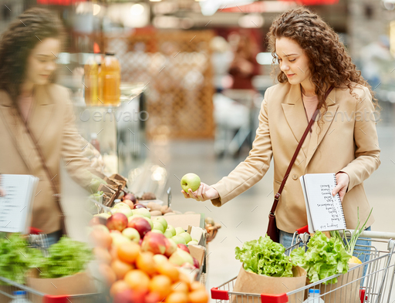
Typical Organic Products Customers
Customers who are female and young with higher affluence grades are typical organic product customers
Notes:
Combine with the model we choose and the graphs we previous showed on Exploratory Analysis .
We found that the customers who are female and young with higher affluence grades are typical organic product customers.
Further, our final model also validates the profile of this type of customer. Based on the decision tree analysis, the final model indicates that customers who are under 44.5 years of age, have an affluence grade between 14.5 and 18.5, have spent less than $2367.505 in the store this year, and have been loyalty card members for less than 6.282 years have an 94.7% chance of purchasing organics. ( Based on the node in the model)

Slide 8
Marketing Strategies
Create
Create Targeted Marketing Campaigns
Provide
Provide Exclusive Offers and Loyalty Programs
Improve
Improve In-Store Placement and Visibility
Notes:
Here are some recommendations to increase the sales of organic products among target demographic.
Firstly, we could create tailored marketing strategies that focus on female and young customers with higher affluence grades.
Secondly, we could introduce exclusive offers such as special discounts specifically designed for customer who are most likely to buy organics.
Lastly, we could designate specific sections or aisles in the store that prominently display organic products aimed at this target demographic to improve in-store placement and visibility.

